Slide 1
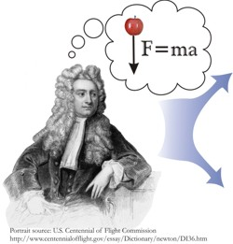
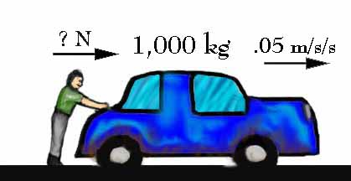
Notes 2.2: Newton’s 2nd Law of Motion

Slide 2
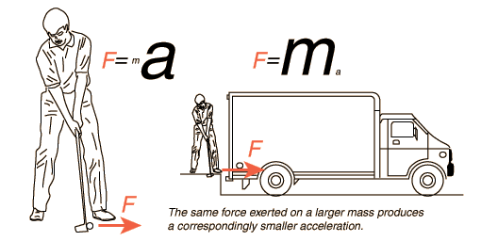
Force = mass x acceleration
Units: Force (N), mass (kg), acceleration (m/s²)
F = ma
The greater the net force on an object, the greater the acceleration.
If we keep the force the same, and increase the mass, the acceleration will decrease.

Slide 3
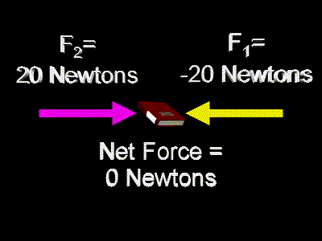
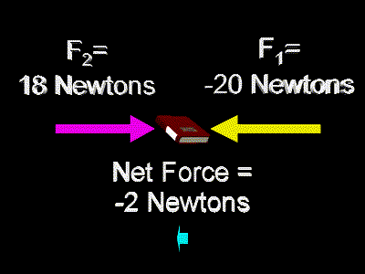
The net force is what causes acceleration.
If there is no acceleration, then the net force = 0 N
If an object is accelerating, then there must be a net force.

Slide 4
A car has a mass of 1,000 kg. If a net force of 2,000 N is exerted on the car, what is its acceleration?
m =1000kg
F = 2000N
a = ?
F = ma
2000 = 1000 x a
a = 2 m/s²

Slide 5
A student applies a force of 7 N to a book and the book accelerates at a rate of 3 m/s^{2.} What is the mass of the book?
F = 7N
A = 3 m/s²
m = ?
F =ma
7 =m x3
m = 2.33 kg

Slide 6
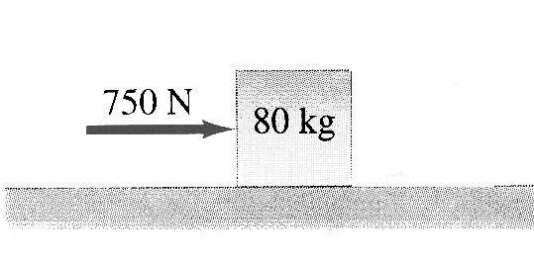
What is the acceleration of the box shown?
F =750 N
m = 80kg
a = ?
F =ma
750 = 80 x a
a = 9.4 m/s²

