Slide 1
Current, Voltage, Resistance & Ohm’s Law
13.2 & 13.3

Slide 2
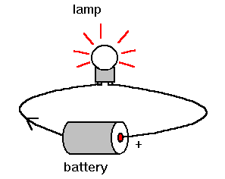
Current
Definition:
Flow of electric charge
How many electrons pass a given point each second
Water Analogy:
Rate at which water flows
Units:
Amps (A)
Symbol in Equation:
I

Slide 3
Voltage
Definition:
Measure of electric potential energy (force or push)
Water Analogy:
Water pressure
Tilt of water pipe
Units:
Volts (V)
Symbol in Equation:
V

Slide 4
Resistance
Definition:
Opposition to the flow of charge
The greater the resistance the less current will flow
Water Analogy:
Rocks in a stream
Nozzle size of water bottle
Units:
Ohms (Ω)
Symbol in Equation:
R

Slide 5
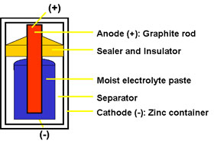
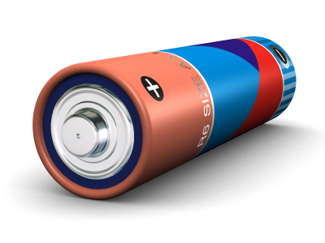
Batteries
Use chemical energy to create a voltage difference, to store electrical energy
Batteries are similar to water towers
Regular batteries can be 1.5 V

Slide 6
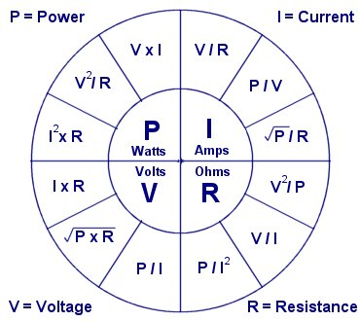
Ohm’s Law
Relationship between current, voltage, and resistance
V = I x R
Voltage = Current x Resistance

Slide 7
Calculate the current in a toaster that has a heating element of 14 ohms when connected to a 120 volt outlet
R = 14Ω
V = 120V
I = ?
V = IR
120 = I ( 14)
I = 8.57A

Slide 8
What is the resistance of a heat coil on an electric stove if it pulls 4 amps of current when plugged intro a 240 volt outlet?
I = 4A
V = 240V
R = ?
V = IR
240 = 4(R)
R = 60Ω

Slide 9
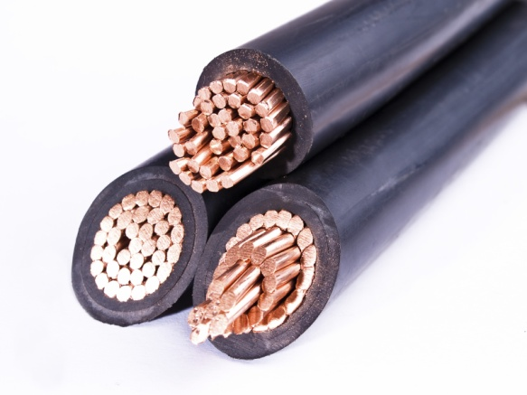
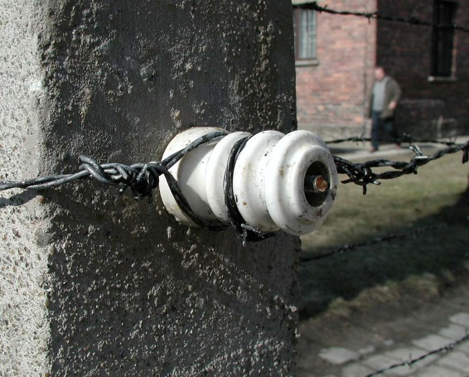
Conductor & Insulator
Conductor
Conduct electricity easily (e⁻ free to move)
Low resistance
Most metals
Insulator
Block the flow of current (e⁻ bound tightly to atom)
High resistance
Rubber, glass, wood, plastic

Slide 10
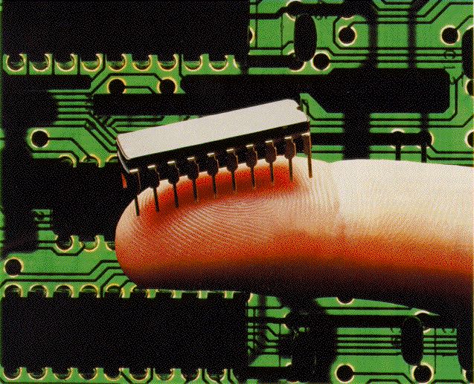
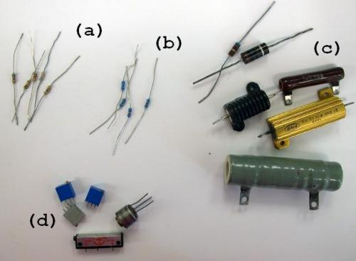
Semiconductor & Resistor
Semiconductor
In-between a conductor and an insulator
Silicon
Resistor
Used to control current
Used in televisions, computers and radios

