Slide 1
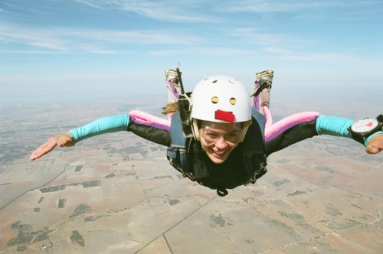
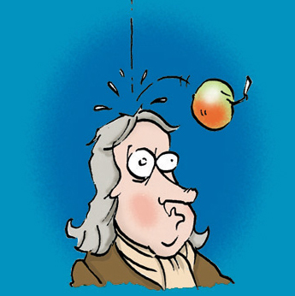
Notes 2.3:Gravity and Freefall

Slide 2
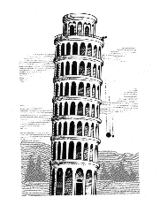
All objects in a state of freefall, regardless of mass, experience uniform acceleration.
Gravity will cause objects to accelerate downward at 9.8 m/s².
g = acceleration due to gravity.
We will use g = 10 m/s² to make the math easier.

Slide 3
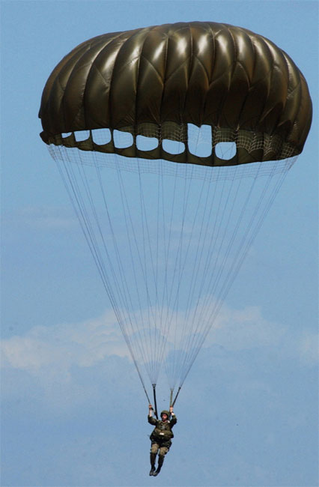
This number ignores air resistance.
Objects that are affected by air resistance will fall slower.

Slide 4
Complete this data table using g = 10 m/s²
We will use these 2 formulas:
v = gt d = ½ gt²
Time (s) | Speed (m/s) | Distance (m)
0
1
2
3
4
5
6

Slide 5
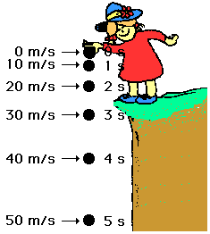
What do you notice about the distance the object falls as the time increases? Is it increasing by the same amount each time?

Slide 6
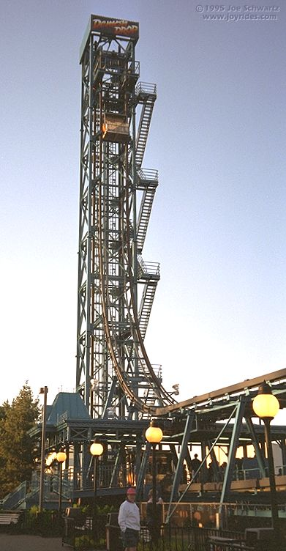
The Demon Drop is in freefall for 2.5 seconds. How far does it drop in this time?

Slide 7
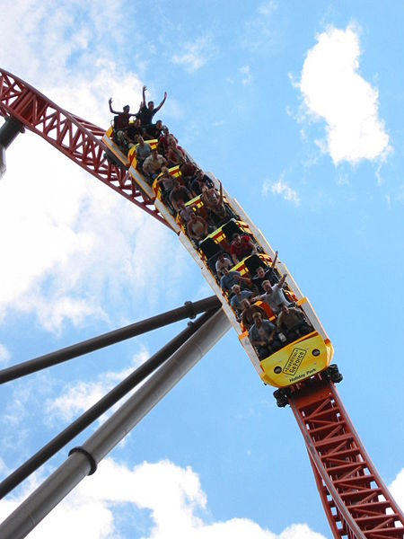
A roller coaster car falls from 120 meters. How long did it fall for?

Slide 8
A water balloon is dropped from a tall building. If it falls for 6.41 seconds before hitting the ground, what is the balloon’s velocity the instant before impact?

Slide 9
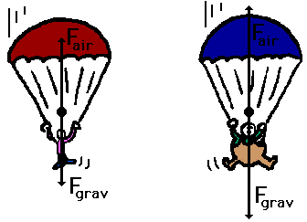
When an object is in free fall, we can easily calculate its velocity the moment before impact using this formula: v =
where h is the height of the falling object, g = 10m/s², and v is velocity
We will ignore the effects of friction and air resistance in the following problems.

Slide 10
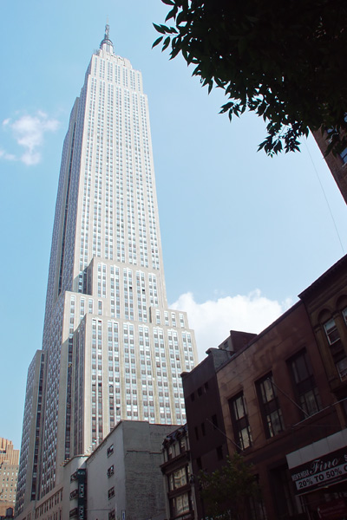
Example #1
What would be the speed of a penny dropped off the top of the Empire State Building (443m tall) the instant before it hits the ground?

Slide 11
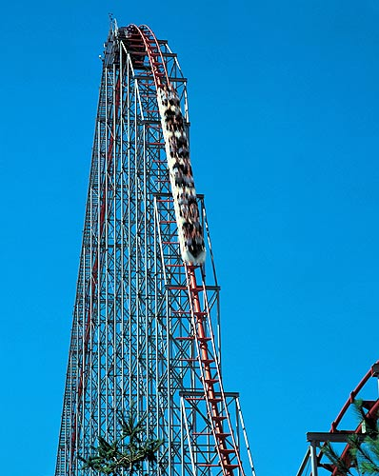
Example #2:
The Magnum roller coaster at Cedar Point has a top speed of 35.5 m/s at the bottom of the tallest hill. How tall is this tallest hill?

Slide 12
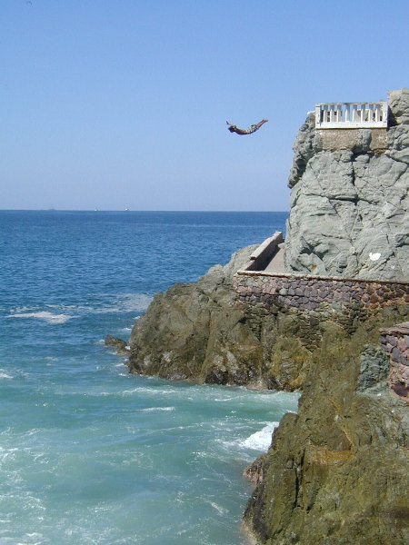
Suppose you fall off of a tall cliff overlooking the ocean. The instant before you hit the water, you are going 73 m/s. How far did you fall?

Slide 13
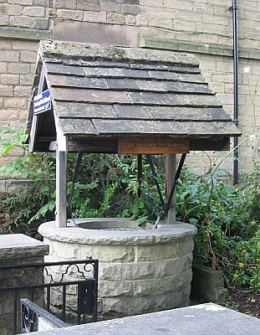
2. A stone is dropped into a well that is 35 meters deep. At what speed does it hit the bottom?

Slide 14
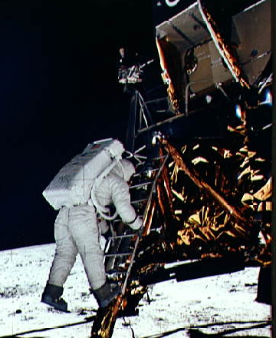
3. Neil Armstrong was the first person to walk on the Moon. When he jumped off of the lunar lander onto the surface of the Moon, he fell 2 meters and his speed upon hitting the ground was 2.5 m/s. What is the acceleration due to gravity (g) on the Moon? (Hint: it is less than 10m/s² since the Moon has less gravity)

