Slide 1
Wave Properties
Frequency & wavelength are inversely proportional
c = λν
Maxwell proved all electromagnetic waves travel at the speed of light (c) (3.00 X 10⁸ m/s)

Slide 2
“Quantum Theory”
The energy of a photon (or an electron) is proportional to its frequency.
E = hν
E: energy (J, joules)
h: Planck’s constant (6.6262 × 10⁻³⁴ J·s)
ν: frequency (Hz)

Slide 3
The Photoelectric Effect (Einstein 1905)
Light
More Light
Higher
frequency
light
Faster
electron
Electron
Electron
Electron
Nucleus
Metal
Nucleus
Metal
Nucleus
Metal
A B C
When light strikes a metal surface,
electrons are ejected ONLY if a
threshold frequency of light is applied
If the threshold frequency has been
reached, increasing the intensity only
increases the number of electrons ejected.
If the frequency is increased, the
ejected electrons will travel faster.

Slide 4
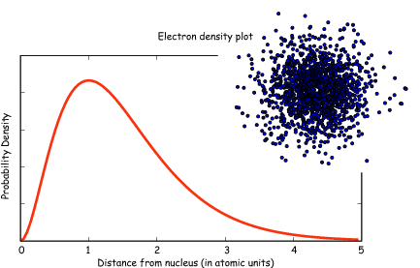
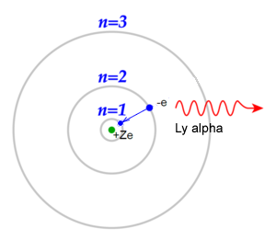
Classic Shell Model of Atom vs
Quantum Mechanical Model
Quantum Mechanical Model
Developed by Schrodinger and the position of an electron is now
represented by a wave equation
Most probable place of finding an electron is called an ORBITAL (90% probability)
Each orbital can only hold 2 electrons with opposing spins (S, P, D & F orbitals)
Evidence for this theory:
Work of DeBroglie and PLanck that electron had wavelike characteristics
Heisenberg Uncertainty Principle - impossible to predict exact location of electron- contradicted Bohr
This new evidence caused the Shell Theory to be replaced by the Quantum Mechanical Model of the atom
Shell Model - Bohr
Developed by Schrodinger and the position of an electron is now
represented by a wave equation
Most probable place of finding an electron is called an ORBITAL (90% probability)
Each orbital can only hold 2 electrons with opposing spins (S, P, D & F orbitals)
Evidence for this theory:
Work of DeBroglie and Planck that electron had wavelike characteristics
Heisenberg Uncertainty Principle - impossible to predict exact location of electron- contradicted Bohr
This new evidence caused the Shell Theory to be replaced by the Quantum Mechanical Model of the atom
Video
LO 1.12: Explain why data suggests (or not) the need to refine a model from a classical shell model with the quantum mechanical model

Slide 5
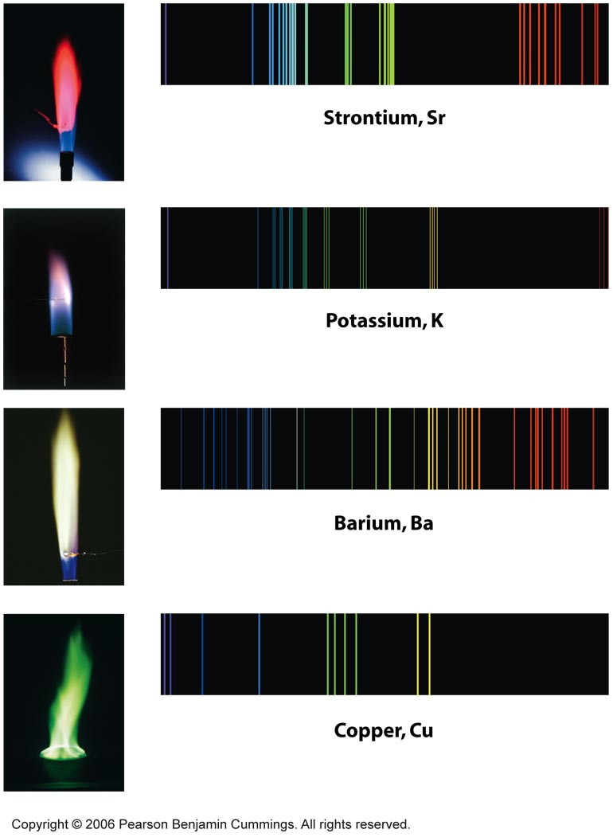
Flame Emission Spectra

Slide 6
Electronic Structure of the Atom: Electron Configurations
Electrons in occupy orbitals whose energy level depends on the nuclear charge and average distance to the nucleus
Electron configurations & orbital diagrams indicate the arrangement of electrons with the lowest energy (most stable):
Electrons occupy lowest available energy levels
A maximum of two electrons may occupy an energy level
Each must have opposite spin (±½)
In orbitals of equal energy, electrons maximize parallel unpaired spins
Video
LO 1.5: The student is able to explain the distribution of electrons in an atom or ion based upon data.

Slide 7
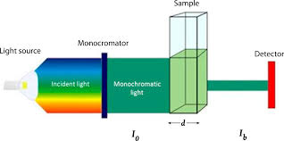
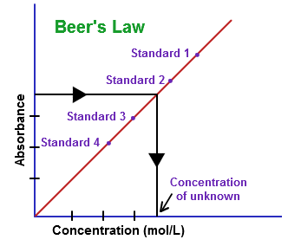
Beer-Lambert Law - used to measure the concentration of colored solutions
Source 1, 2
Video
A = abc
A = absorbance
a = molar absorptivity (constant for material being tested)
b = path length (cuvette = 1 cm)
c = concentration
Taken at fixed wavelength
LO1.16: Design and/or interpret the results of an experiment regarding the absorption of light to determine the concentration of an absorbing species in solution

Slide 8
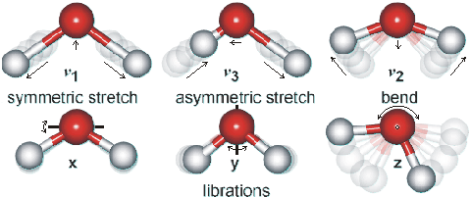
Using Spectroscopy to measure properties associated with vibrational or electronic motions of molecules
IR Video
UV Video
IR Radiation - detects different types of bonds by analyzing molecular vibrations
UV or X-Ray Radiation
Photoelectron Spectroscopy(PES)
Causes electron transitions
Transitions provides info on
electron configurations
LO: 1.15 Justify the selection of a particular type of spectroscopy to measure properties associated with vibrational or electronic motions of molecules

Slide 9
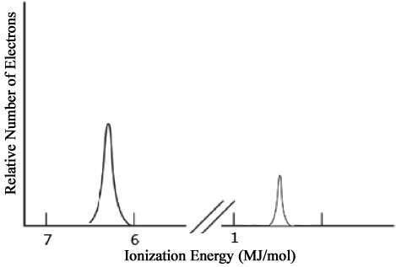
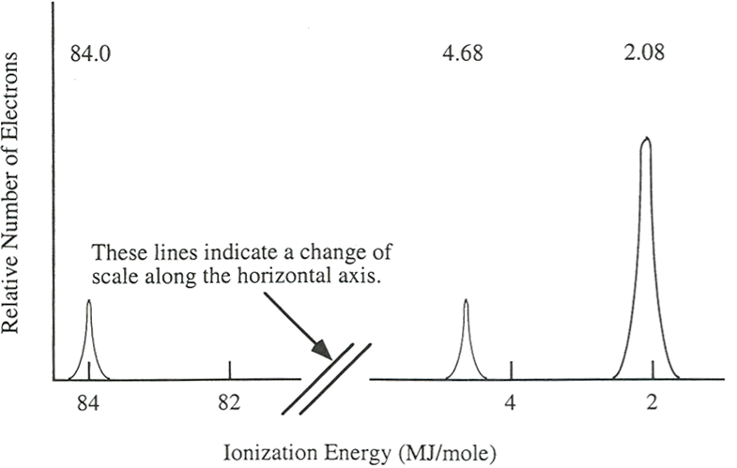
Electronic Structure of the Atom: Photoelectron Spectroscopy (PES)
Li
PES uses high-energy (X-ray) photon to excite random e– from atom
KE of ejected electron indicates binding energy (coulombic attraction) to nucleus:
BE = hv_{photon} – KE
Direct measurement of energy and number of each electron
Lower energy levels have higher BE
Signal size proportional to number of e– in energy level
Elements with more protons have stronger coulombic attraction, higher BE at each energy level
1s²
Video
2s¹
Ne
2p⁶
1s²
2s²
LO 1.7: The student is able to describe the electronic structure of the atom, using PES data, ionization energy data, and/or Coulomb’s law to construct explanations of how the energies of electrons within shells in atoms vary.

Slide 10
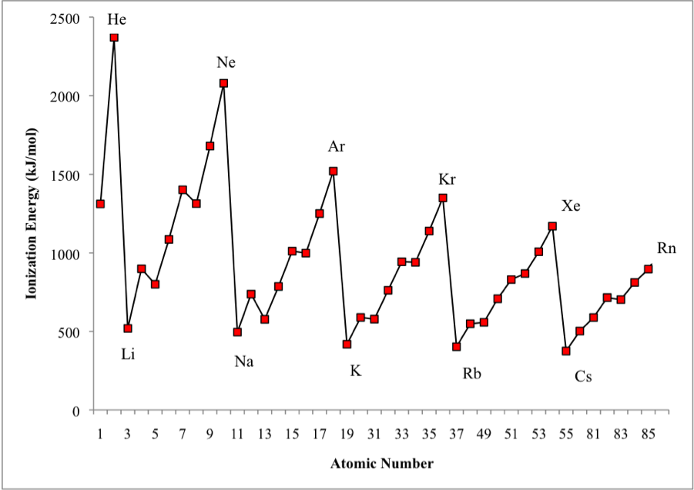
Shell Model is consistent with Ionization Energy Data
The patterns shown by
the IE graph can be
explained by Coulomb’s law
As atomic number increases, would expect the ionization energy to constantly increase
Graph shows that this is NOT observed. WHY NOT?
The data implies that a shell becomes full at the end of each period
Therefore the next electron added must be in a new shell farther away from the nucleus.
This is supported by the fact that the ionization energy drops despite the addition positive charge in the nucleus
Video
LO: 1.13 Given information about a particular model of the atom, the student is able to determine if the model is consistent with specified evidence

Slide 11
Electronic Structure of the Atom: 1st Ionization Energy
1st Ionization Energy Energy (IE) indicates the strength of the coulombic attraction of the outermost, easiest to remove, electron to the nucleus:
X(g) + IE X⁺(g) + e–
1st IE generally increases across a period and decreases down a group
IE generally increases as #protons increases in same energy level
IE decreases as e– in higher energy level: increased shielding, e– farther from nucleus
Video
LO 1.6: The student is able to analyze data relating to electron energies for patterns and relationships.

Slide 12
Electronic Structure of the Atom: 1st Ionization Energy Irregularities
1st Ionization Energy Energy (IE) decreases from Be to B and Mg to Al
Electron in 2p or 3p shielded by 2s² or 3s² electrons, decreasing coulombic attraction despite additional proton in nucleus.
Same effect seen in 3d¹⁰-4p, 4d¹⁰-5p and 5d¹⁰-6p
1st Ionization Energy decreases from N to O and P to S
np⁴ contains first paired p electrons, e–-e– repulsion decreases coulombic attraction despite additional proton
Video
LO 1.8: The student is able to explain the distribution of electrons using Coulomb’s law to analyze measured energies.

Slide 13
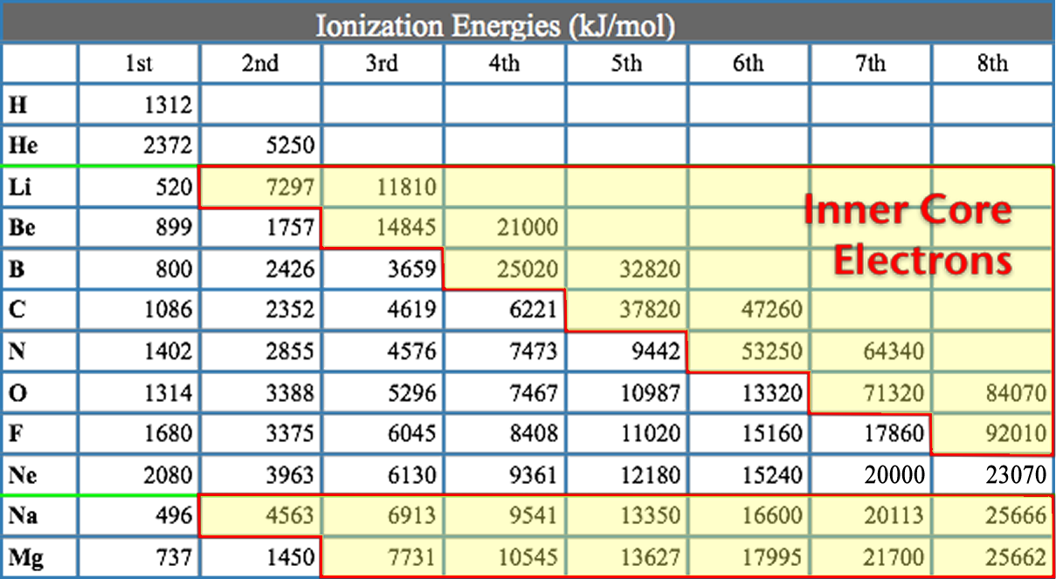
Electronic Structure of the Atom: Higher Ionization Energies
2nd & subsequent IE’s increase as coulombic attraction of remaining e–’s to nucleus increases
X⁺ + IE X²⁺ + e–
X²⁺ + IE X³⁺ + e–
Large jump in IE when removing less-shielded core electrons
Video
LO 1.8: The student is able to explain the distribution of electrons using Coulomb’s law to analyze measured energies.

Slide 14
Predictions with Periodic Trends
Video
The following explains these trends:
Electrons attracted to the protons in the nucleus of an atom
So the closer an electron is to a nucleus, the more strongly it is attracted (Coulomb’s law)
The more protons in a nucleus (effective nuclear charge), the more strongly it attracts electrons
Electrons are repelled by other electrons in an atom. If valence electrons are shielded from nucleus by other electrons, there will be less attraction of the nucleus (again Coulomb’s law-greater the atomic radius, the greater the distance)
L.O. 1.9 The student is able to predict and/or justify trends in atomic properties based on location on periodic table and/or the shell model

Slide 15
Chemical Reactivity
Using Trends
Nonmetals have higher electronegativities than metals --> causes the formation of ionic solids
Compounds formed between nonmetals are molecular
Usually gases, liquids, or volatile solids at room temperature
Elements in the 3rd period and below can accommodate a larger number of bonds
The first element in a group (upper most element of a group) forms pi bonds more easily (most significant in 2nd row, non-metals)
Accounts for stronger bonds in molecules containing these elements
Major factor in determining the structures of compounds formed from these elements
Elements in periods 3-6 tend to form only single bonds
Reactivity tends to increase as you go down a group for metals and up a group for non-metals.
Video
L.O. 1.10: Students can justify with evidence the arrangement of the periodic table and can apply periodic properties to chemical reactivity

Slide 16
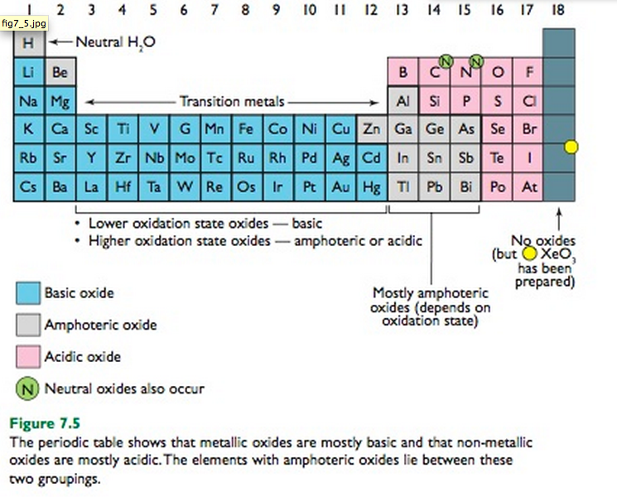
Chemical Properties within a Group and across a Period
Group 1 metals more
reactive than group 2
metals
Reactivity increases as you go down a group
Metals on left form basic oxides
Ex. Na₂O + H₂O → 2 NaOH
Nonmetals on right form form acidic oxides
Ex. SO₃ + H₂O → H₂SO₄
Elements in the middle, like Al, Ga, etc can behave amphoterically
If SiO₂ can be a ceramic then SnO₂ may be as well since both in the same group
Video
attracts
LO 1.11: Analyze data, based on periodicity & properties of binary compounds, to identify patterns & generate hypotheses related to molecular design of compounds

Slide 17
Atomic Radii of Representative Elements (nm)
1A 2A 3A 4A 5A 6A 7A
Li
Be
B
C
N
O
F
0.152 0.111
0.088 0.077 0.070 0.066 0.064
Na
Mg
Al
Si
P
S
Cl
0.186 0.160
0.143 0.117 0.110 0.104 0.099
K
Ca
Ga
Ge
As
Se
Br
0.231 0.197
0.122 0.122 0.121 0.117 0.114
Rb
Sr
In
Sn
Sb
Te
I
0.244 0.215
0.162 0.140 0.141 0.137 0.133
Cs
Ba
Tl
Pb
Bi
Po
At
0.262 0.217
0.171 0.175 0.146 0.140 0.140

Slide 18
Trends in Atomic and Ionic Size
Metals
Nonmetals
Group 1
Group 13
Group 17
e
e
Li
Li⁺
F⁻
F
152
60
64
e
136
e
e
e
e
Na
Na+
Al
Al³⁺
Cl⁻
Cl
95
143
50
99
186
181
e
e
K
K+
Br⁻
Br
133
114
227
195
Cations are smaller than parent atoms
Anions are larger than parent atoms

Slide 19
Causes Which Drive Trends
Principal Energy Level: Each level adds a new “s” orbital (subsequently larger)
Nuclear Charge: the charge of the nucleus (attractive force on electrons)
Shielding: the effect of inner “core” electrons to shield valence electrons from nuclear charge
e-/e- Repulsion: same charges repel
***In summary, it’s all about F = kq₁q₂/d²

